Slide 1
TMCC Admissions & Records
RDMT 319
Administrative Withdrawals, Grade Rosters, Add/Drops, and Grade Changes

Slide 2
Check Class Rosters in MyTMCC/PeopleSoft Throughout Term
All student adds and drops are processed through PeopleSoft, not Canvas. PeopleSoft is the official record keeping system for the college.
Students can add full term classes through the third week of classes.
First week: students can add themselves
Second week: Add/Drop form signed by instructor & chair
Third week: Add/Drop form signed by instructor, chair, and dean
Students can drop Spring full term classes through March 30, 2023.
Throughout the term Accounting Services runs purges of students who have signed up for a payment plan and have not made payments or students not on a payment plan who have an unpaid balance.
Students receive notices through their TMCC emails but may not always check.
Students dropped for non-payment must resolve their financial issues before they can be added back into a class.

Slide 3
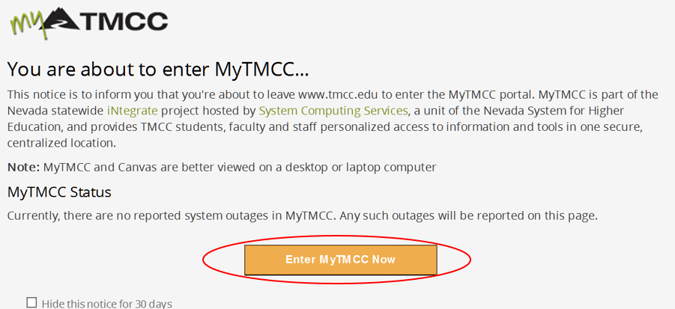
How to check your class roster
Go to my.tmcc.edu:

Slide 4
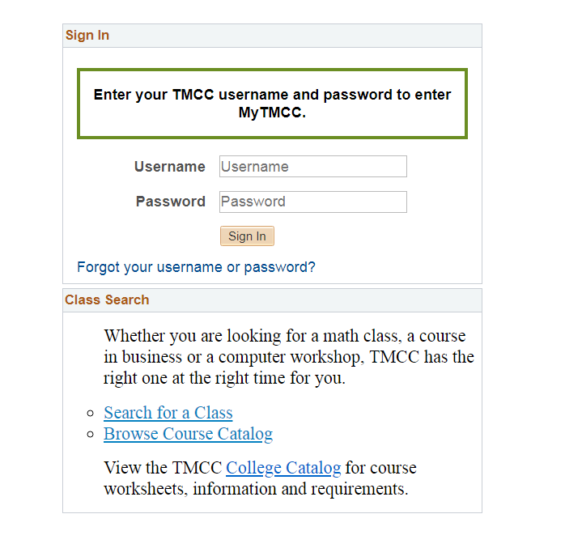

Slide 5
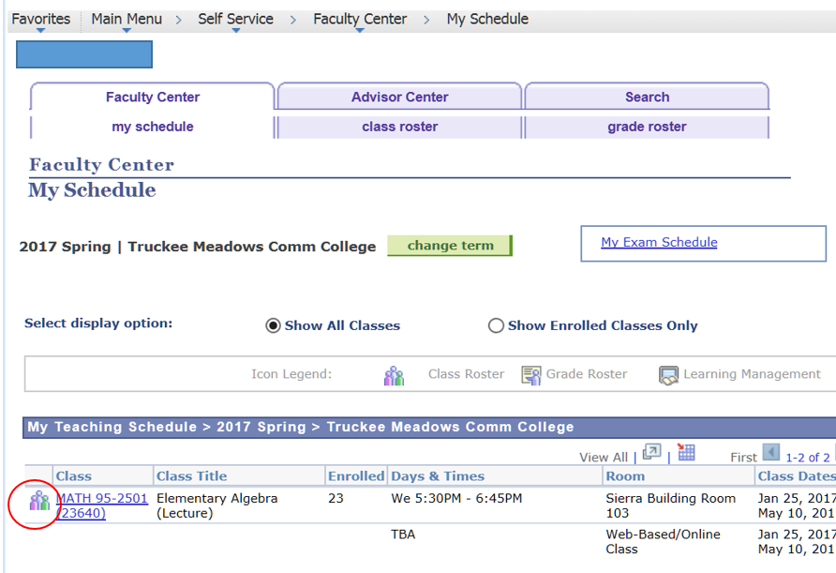

Slide 6
Basic Guidelines:
TMCC guideline is to Administratively Withdraw a student if they do not contact you or attend the first days of class OR by 12 noon on the second day of an online class (Wednesday or Thursday of the first week of classes). This procedure is to be used during the first week—the 100% refund period—of full-term classes. Spring 2023 last day of 100% refund is Sunday, January 29, 2022.
Please check your TMCC email prior to class to make sure the student did not try to contact you regarding missing the first class.
The reasoning: students can add or drop themselves from full term classes during the first week of the term. If a student does not attend the first classes, dropping the student gives another person the chance to take that empty seat.
Dropping students for non-attendance also helps our colleagues in Financial Aid and Veterans Benefits.
During the first week of FULL TERM classes, you can easily drop a student using your class roster in PeopleSoft.
NOTE: Short term classes most frequently have a ONE DAY 100% refund period. For all shorter classes, you will use an Administrative Withdrawal Form, that you can access through: www.tmcc.edu/admissions/faculty-resources.

Slide 7
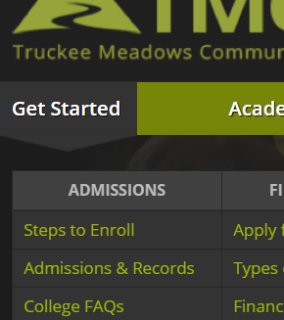
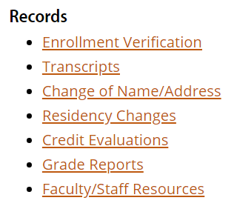
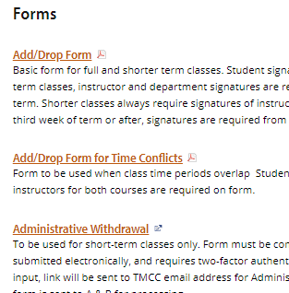
Forms are available on the TMCC website>Admissions and Records>Faculty/Staff Resources
Scroll down the landing page and click on Faculty/Staff Resources under Records
From www.tmcc.edu, under ‘Get Started,’ click on Admissions and Records
You’ll then see the page with links to forms, tutorials, and general information

Slide 8
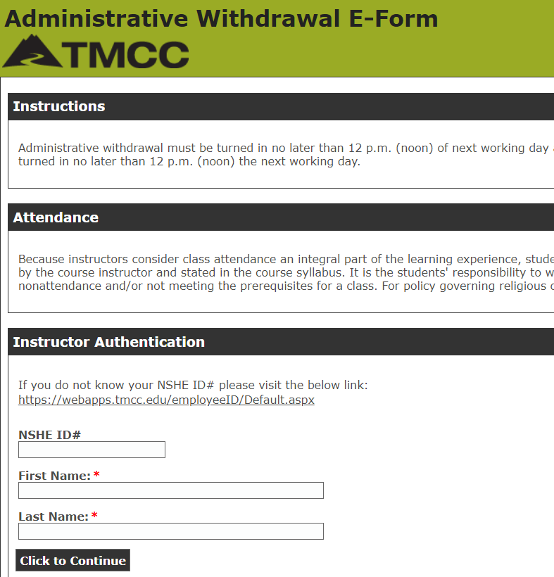
Two-Factor Authentication needed for Grade Change and Administrative Withdrawal Forms
All forms are hyperlinked—just click on the link and the form will load.
However, for your protection, Grade Change and Administrative Withdrawal forms require two-factor authentication.
Click on the link for either of these forms and you’ll be directed to input your 10-digit NSHE ID (will start with a 1, 2, 5, or 8) and your name.
Once you submit the form, an email is sent to your TMCC faculty email. The form will be in that email.
When the form is filled out and SUBMIT is clicked, the form is electronically sent to the department chair/director/coordinator and then to the dean for approval.
The form is then sent to Admissions & Records where it is processed.

Slide 9
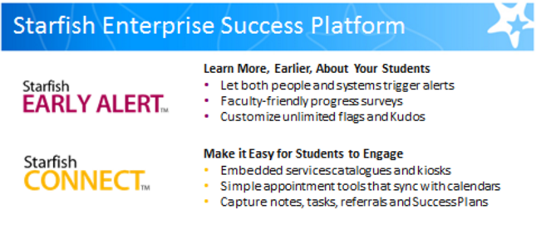
How to help students: STARFISH
Starfish is a retention program, accessible through Canvas, that allows instructors to, among other things, connect struggling students with tutoring, academic advising, and counseling. Starfish Early Alert will be active as of January 30, 2023, to allow you to use the networking abilities to help students.
Starfish allows you to send kudos to students who are showing progress as well.
For help using Starfish, contact starfishassistance@tmcc.edu and for technical issues contact HelpDesk@tmcc.edu

Slide 10
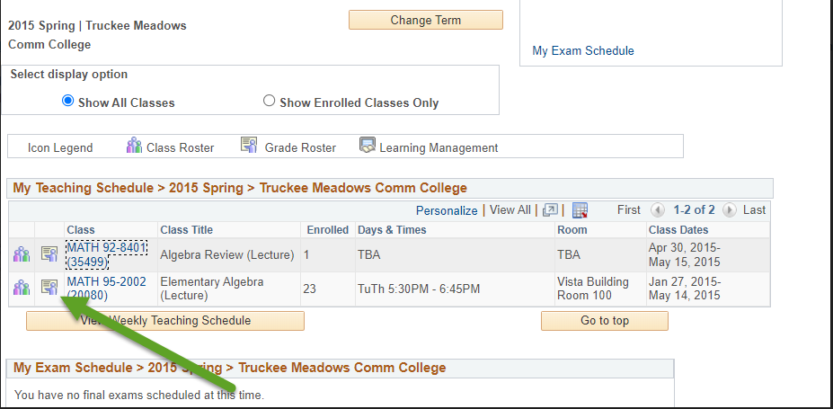
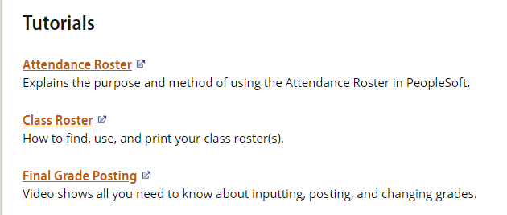
Grade Rosters
Created the week prior to a class ending.
The tutorial for posting grades is always available: www.tmcc.edu/admissions/faculty-resources.
Or, go to main TMCC webpage: www.tmcc.edu
Under ‘Get Started’ click on Admissions and Records
Scroll to the Records list and click on Faculty/Staff Resources.
Scroll to Tutorials section and choose Final Grade Posting.

Slide 11
Help!
Administrative Assistant for your Academic Department
Part-Time Faculty Office ptf@tmcc.edu
Admissions and Records
Jamie Rittenbach, NSHE Specialist II
775-673-7195, jrittenbach@tmcc.edu
Janet Bicker, Administrative Assistant III
775-857-4975, jbicker@tmcc.edu
Lee Raubolt, Associate Director
775-674-7624, lraubolt@tmcc.edu

